Slide 1
Warebots: Simultaneous Agent Routing
16782- Planning and Decision Making in Robotics Project
Aman Chulawala
Aneesh Sinha
Prakrit Tyagi

Slide 2
Motivation

Slide 3
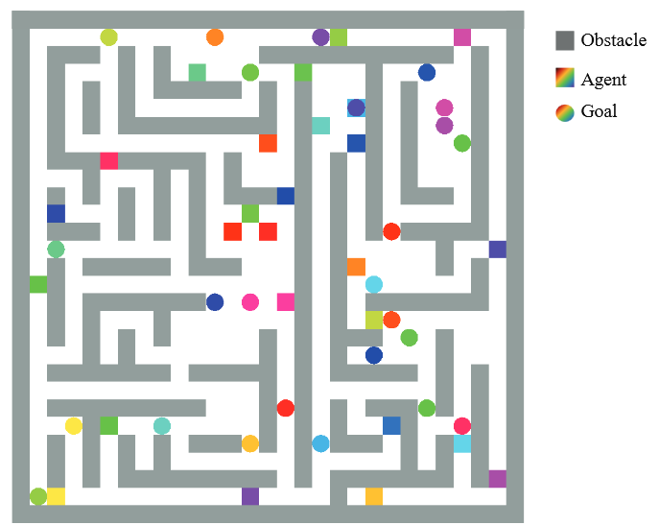
The Problem of Multi Agent Path Planning
Given a 4 connected Grid, N-agents are trying to maximize task completion under time constraint while avoiding path conflict.
M. Daman et. al., "PRIMAL_2: Pathfinding Via Reinforcement and Imitation Multi-Agent Learning - Lifelong,"

Slide 4


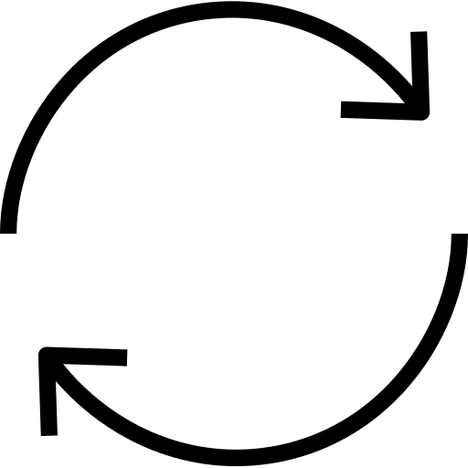
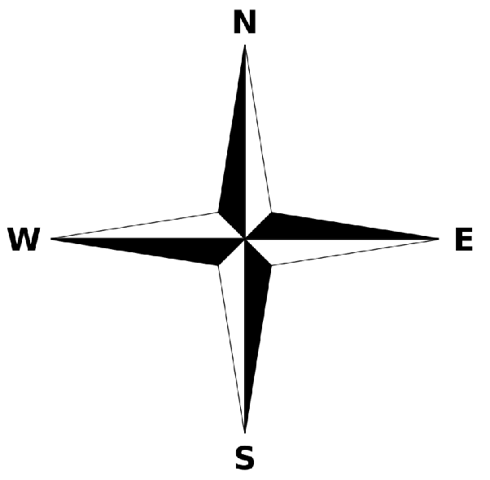
Problem Variables
Action
F
CW 90°
CCW 90°
W
State
X
Y
{N,E,W,S}
Goal
X
Y
Robot can move Forward, or Rotating 90 degrees at one location.

Slide 5
Problem Variables
Edge Conflict
Vertex Conflict
A
Next Cell
(A, B, V1, V2, t)
(A, B, V, t)
B
A
B

Slide 6
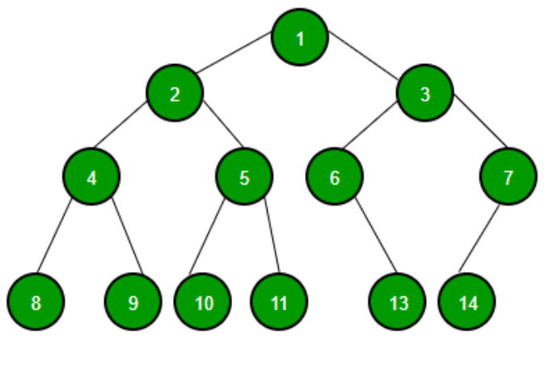

Planning Algorithm: Conflict Based Search
Path of robots
Constraint set
Sum of cost
BFS
Multiple runs of A* or Dijkstra

Slide 7
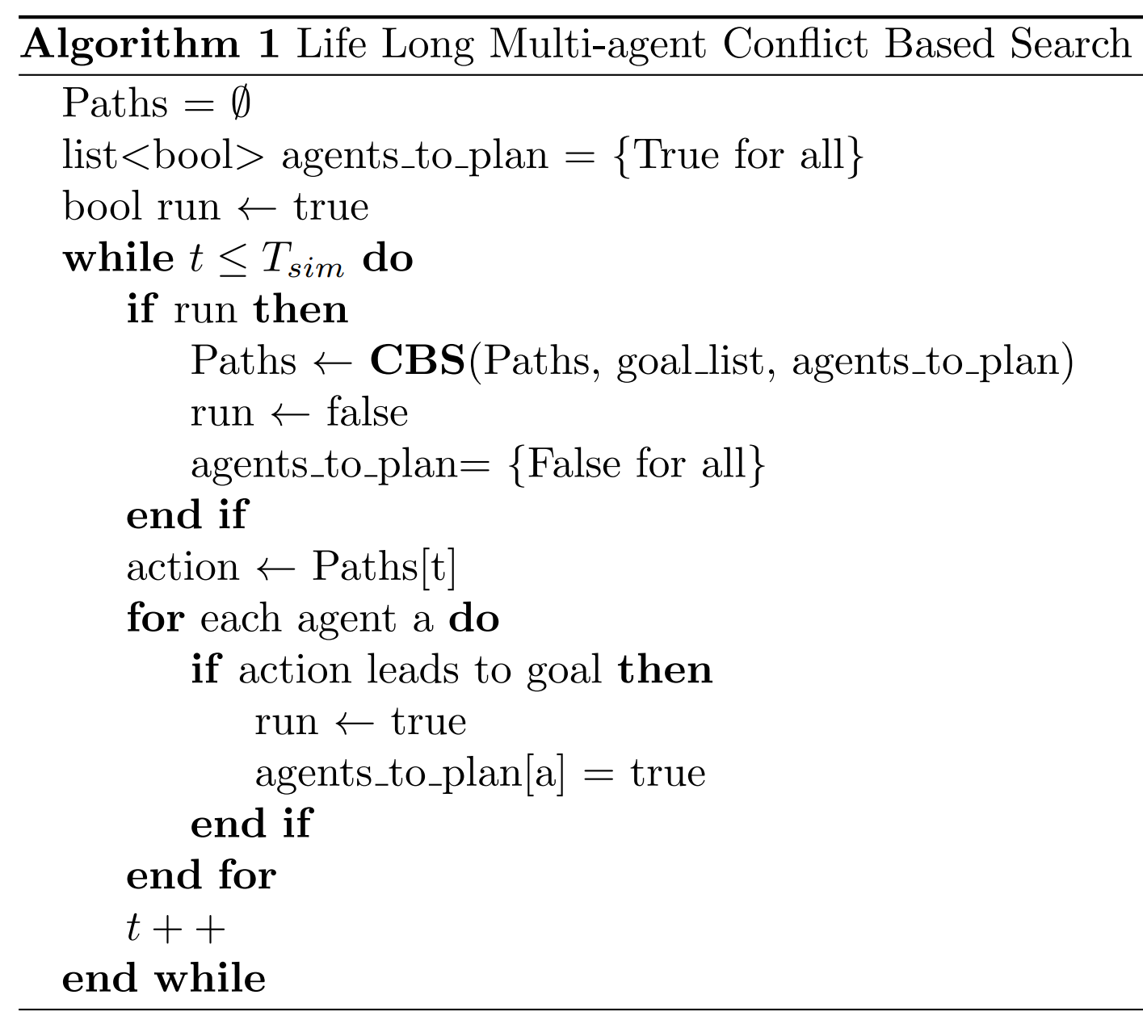
Pseudocode
Initialize variables
Run while loop for time T_sim
CBS give solution & set variables to false
Execute action for time step t
Only if a action of an agent leads to goal, set variables to true. Since one task is complete. We will run CBS again!!
Increment time

Slide 8
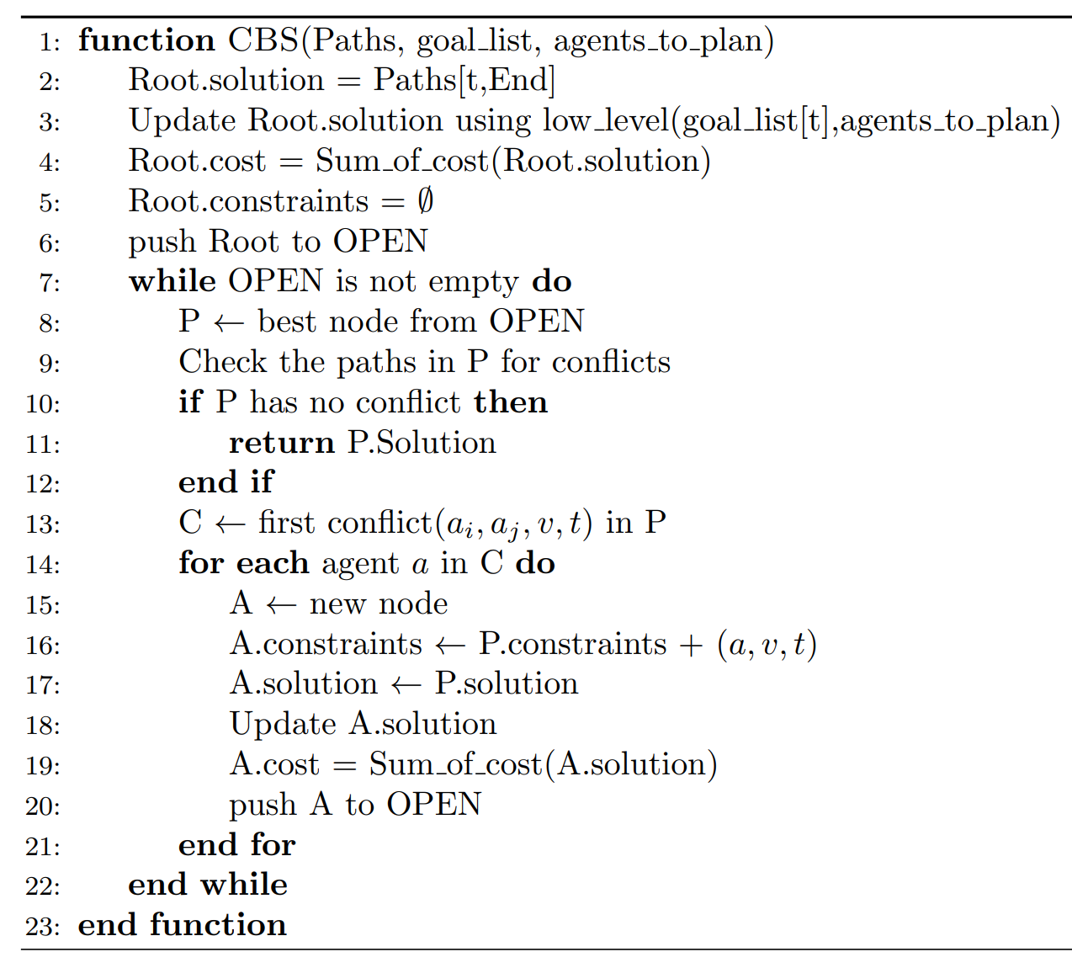
Pseudocode
1. Create a root node
2. Reuse solution from previous CBS call

Slide 9
Pseudocode
3. Call low level planner only on agents for which
agents_to_plan is true.

Slide 10
Pseudocode
Take the first conflict that you find and split the parent node.
Parent nodes constraints are propagated into child
Copy parent solution into child node and only update agent a path by calling low lever planner

Slide 11
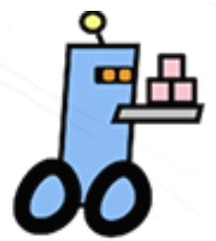
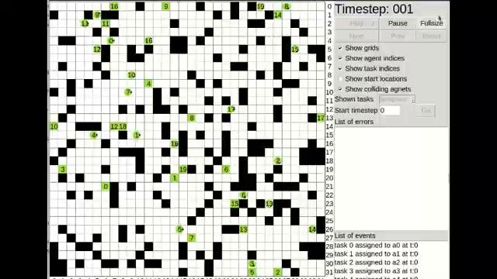
Demonstration Video: PlanViz
2x Speed
Notes:
We tested our modified algorithm on several maps, and here we see results from two of the environments where we ran the plannerfor around 20 agents. For visualisation purposes we use the PlanViz script. The moving circles here represent individual agents, and the stationary boxes represent assigned tasks.

Slide 12
Results
Metric | Warehouse map | Random map
Dimension | 33x57 cells | 32x32 cells
# of Agents | 25 | 20
Task done | 3666 | 3416
Solve time | 72.722 sec | 70.821 sec
Std in solve time | 3 sec | 3 sec
Avg Tree expansion | 8.3 per CBS calls | 5.2 per CBS calls
Total CBS calls | 2625 | 2492
Notes:
Each simulation is nearly an hour and a half long, and we can plan for all trajectories for the entire duration in just over a minute. For each map, the planner with 20-25 agents can complete nearly 3500 tasks in its lifetime.

Slide 13
Discussion and Future Work
Augmented CBS Planning is capable of managing more agents than Naive CBS
Lifelong Augmented CBS is capable of planning for new tasks while keeping track of best results from the last run
Currently working on implementing features of
Improved Conflict Based Search
Enhanced Conflict Based Search
Increasing Scalability of existing pipeline
Notes:
Takeaways from the results is the planning pipeline works extremely well for small scale environments, however, there os scope for improvement. We plan on adding some more

Slide 14
Thank You

Slide 17
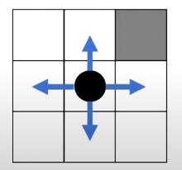
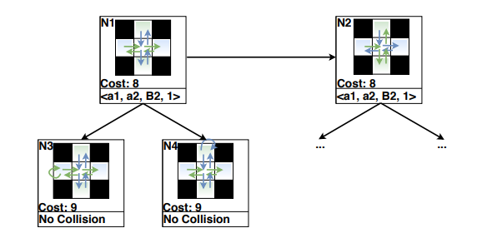
http://idm-lab.org/bib/abstracts/papers/aaai21b.pdf

